Slide 1
Data Communications and Networks
Chapter 1 - Classification of network topologies

Slide 2
Agenda
Physical Topologies;
Point-to-Point;
Bus;
Star;
Ring;
Mesh;
Tree.
Logical Topologies
Shared and Token Topologies

Slide 3
Objective
By the end of this lesson, the student will be able to identify the different technologies around the physical and logical topologies.

Slide 4
Pre-assessment
What do you know about?
Physical and Logical Topologies;
Ethernet;
HUBs;
Switches.

Slide 5
Network Topologies
There are two basic categories of network topologies:
Physical topologies
Logical topologies

Slide 6
Physical Topologies

Slide 7
Point-to-point
It’s a topology is a permanent link between two endpoints. This is the simplest network topology.
Pros:
Connect long distance locations;
Simple to implement.
Cons:
Cost of links;
Slower links.

Slide 8
Bus
The Bus network topology uses a common backbone to connect all devices; each machine is connected to a single cable.
Pros
Simple to install;
Inexpensive to implement.
Cons
Performance problems;
High cost of managing the network;
If the backbone cable fails, the entire network effectively becomes unusable (single point of failure).

Slide 9
Star
In the Star Topology there is a central connection point called the hub which is a computer hub or sometimes just a switch.
Pros:
Easy to add new computer stations;
One cable failure won't bring down entire network;
Easy to trouble shoot problem area.
Cons:
Cost of cables depending on number of stations;
Weak point of entire network failure with central device.

Slide 10
Ring
In a ring network, each device has two neighbors for communication purposes. All messages travel through a ring in the same direction.
Pros
Simple to install;
Inexpensive to implement.
Cons
High cost of managing the network;
The network is dependent on the ability of the signal to travel around the ring;
A failure in any cable or device breaks the loop and can take down the entire network.

Slide 11
Mesh
Mesh topologies involve the concept of routes. Unlike each of the previous topologies, messages sent on a mesh network can take any of several possible paths from source to destination.
Pros:
High fault tolerance (partial mesh has lower tolerance);
Reliable and offers redundancy;
If one node can no longer operate, all the rest can still communicate with each other
Cons:
Cost of cables;
Larger the network more complex wiring.

Slide 12
Tree
Tree topologies integrate multiple star topologies together onto a bus.
Pros:
Supports future expandability of the network;
Easy to add new computer stations;
One cable failure won't bring down entire network;
If the root fails, the communication between the networks will fail too (weak point of entire network failure with central device).

Slide 13
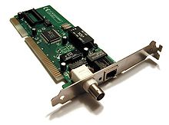
Logical Topologies
The Logical topology defines how the systems communicate across the physical topologies. Logical topology referred to as the LAN media access method or network access method. There are two main types of logical topologies:
shared media topology
token-based topology

Slide 14
Shared Media
In a shared media topology, all the systems have the ability to access the physical layout whenever they need it. The main advantage in a shared media topology is that the systems have unrestricted access to the physical media.
Ethernet
Fast Ethernet

Slide 15
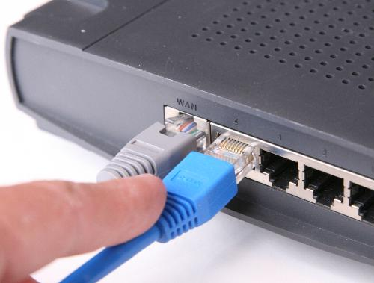
Ethernet
Ethernet is an interconnect technology for LANs - Local Area Network (LAN)-based on sending packets. It defines wiring and signaling for the physical layer of OSI and TCP/IP models, and packet formats and protocol layer for medium access control (Media Access Control - MAC).
Ethernet HUBs;
Switched Network;

Slide 16
Ethernet HUBs
When you are using HUBS, it forms a network with physical star topology, with multiple network interface controllers sending data to the hub and hence the data are then relayed to a backbone, or to other network segments.
However, despite the physical star topology, the hub with Ethernet networks still use CSMA / CD in which every packet that is sent to a port on the hub can undergo collision, the hub performs a minimal amount of work in dealing with packet collisions.
Collisions;
Any computer is able to see the packets sent to other computer at the same subnet;

Slide 17
Switched Networks
Most modern Ethernet installations use Ethernet switches instead of hubs. Although the wiring is identical to an Ethernet hub (shared Ethernet), with switches instead of hubs, switched Ethernet has many advantages over Ethernet media, including higher bandwidth and simplified wiring.
VLANs;
The packet is sent to one computer without the knowledge of another computer the segment;

Slide 18
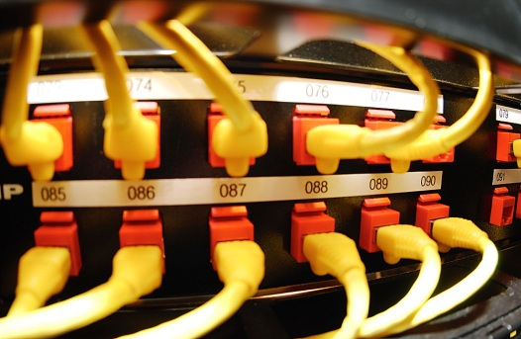
Fast Ethernet
Fast Ethernet is a term for various Ethernet standards that carry data traffic at the nominal rate of 100 Mbit/s against the transmission rate of 10 Mbit/s Ethernet original.
High speed

Slide 19
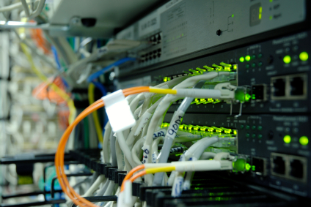
Fiber
An optical fiber or optical fiber is a thin, flexible, transparent fiber that acts as a waveguide, or "light pipe", to transmit light between the two ends of the fiber
100BASE-FX;
100BASE-SX;
100BASE-BX;
100BASE-LX10.

Slide 20
Token Ring
The token-based topology works by using a token to provide access to the physical media.
Obsolete topology;
Collisions;
A failure in any cable or device breaks the loop and can take down the entire network
Stations on a token ring LAN are logically organized in a ring topology with data being transmitted sequentially from one ring station to the next with a control token circulating around the ring controlling access.

Slide 21
Summary
Topologies remain an important part of network design theory. You can probably build a home or small business computer network without understanding the difference between a bus design and a star design, but becoming familiar with the standard topologies gives you a better understanding of important networking concepts like hubs, broadcasts, switches and routes.
To create a network, you have to be prepare to apply the right technologies for the companies needs, which includes requirements such as speed, reliability, security and management. To attend those requirements, you need to understand how chose the right equipment for the right topology.

Slide 22
Questions

