Slide 1
Data Communications and Networks
Chapter 2 - Network Technologies - Circuit and Packet Switching

Slide 2
Agenda
Network Technologies;
Circuit Switching;
Packet Switching;
X.25 Protocol;
Frame Relay;
MPLS.
Exercises

Slide 3
Objective
By the end of this lesson, the student will be able to identify the different technologies for circuit and packet switching.

Slide 4
Pre-assessment
What do you know about?
Circuit and Packet Switching;
Frame Relay;
MPLS.

Slide 5
Network Technologies
There are two basic categories of network technologies:
Circuit Switching;
Packet Switching.

Slide 6
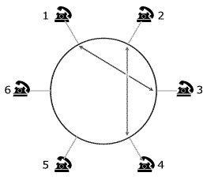
Circuit Switching
Circuit switching in telecommunication networks, is a type of resource allocation for information transfer that is characterized by the continuing use of these resources throughout the broadcast. It is an appropriate technique for communications systems that have constant traffic (eg voice communication), requiring a dedicated connection for the transfer of continuous information.

Slide 7
Circuit Switching – How it works
Essentially, communication via a circuit switching between two stations is divided into three stages: the establishment of the circuit, conversation and disconnect the circuit.
In the first stage, a fixed route between the stations involved is established so that they can communicate;
Then the stations involved can exchange information by transmitting and receiving data through the circuit already established. This data transfer corresponds to the second stage of circuit switching;
After an indeterminate period, the connection is finally closed, usually by the action of one of the communicating stations.

Slide 8
Circuit Switching – Switching
There are three different ways to allocate communication channels in circuit switching. They are:
Switching space: a path is established between two stations via physical links permanent during the whole communication. Along this path, a succession of physical keys, each in an intermediate node, form a circuit through the interconnection between their doors;
Switching frequency: it established an association between two frequency channels on each link.;
Switching time: it established an association of two channels of time on each link.

Slide 9
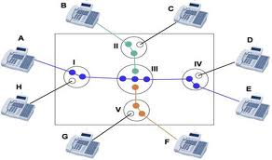
Circuit Switching – Application
Circuit switching is widely used in telephone systems, due to continuous nature featuring the voice communication. This constant behavior of the communication is a determining factor for the employment of this technique, since the use of circuit-switched data transmissions that are characterized by bursts or long periods of inactivity results in wasted capacity of the environment.

Slide 10
Packet Switching
Packet Switching communication paradigm in which packets of data (unit of information transfer) are individually routed between nodes on the network via data links typically shared by other nodes.
is used to optimize the use of the bandwidth of the network, minimize latency (ie, the time that the packet takes to traverse the network) and increase robustness of communication;
is more complex; a greater variation in service quality by introducing various delays, but makes better use of network resources, since they are used statistical multiplexing techniques.

Slide 11
Packet Switching
Packet switching can be accomplished:
With a connection (virtual circuit) established a virtual path is fixed (no fixed parameters, such as circuit switching) and all packages will follow that route. A big advantage is that it provides guaranteed delivery of packets, and in an orderly manner. Exaple: ATM (cell switching), Frame Relay and X.25;
No connection (datagram) packets are routed independently, providing greater flexibility and robustness, since the network can readjust itself by breaking a link data transmission. You must always send the source address. Ex: IP address

Slide 12
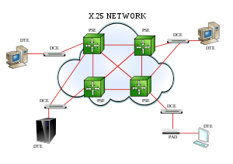
Packet Switching – X.25
X.25 is a set of protocols standardized for wide area networks that use the telephone system or ISDN as a means of transmission;
The X.25 protocol allows access to public or private networks operating with packet switching is driven by bit. Data transmission occurs between the client terminal called Data Terminal Equipment (DTE) and a network device called Data Circuit-terminating Equipment or Data Communications Equipment (DCE);
The transmission of data packets is performed using a connection-oriented service (the source sends a message to the destination connection before asking to send packets), thus ensuring the delivery of data in the correct order, without loss or duplication.

Slide 13
Packet Switching – X.25
X.25 works with three layers of the OSI model:
Physical Layer: defines the mechanical and electrical interface of the Terminal and the Network. It is transmitted in synchronous mode and full duplex;
Link Layer: responsible for initiating, checking, and end the transmission of data on the physical connection between the DTE and DCE. Responsible for timing, detecting and correcting errors during transmission;
Network Layer: responsible for packing the data. Sets whether the transmission is performed by Virtual Circuit (temporary connections established only when the information) or Permanent Virtual Circuit (permanent connections, there is no need to make a call to connect).

Slide 14
Packet Switching – X.25
Links can occur in logical channels (logical channels) of two types:
Switched Virtual Circuit (SVC): The SVCs operate in a similar way to phone calls, a connection is established, data is transferred and the connection is terminated. Each DTE on the network is assigned a unique number that can be used as a phone number;
Permanent Virtual Circuit (PVC): A PVC is similar to a leased line/dedicated as the link is always active. The logical link is established on an ongoing basis by management of the Packet Switched Network. For this reason, data can always be transmitted without the connection. In this type of virtual circuit users are able to establish/draw connections with other users dynamically, as needed (on demand).

Slide 15
Packet Switching – Frame Relay
Frame Relay is an efficient communication technology used to transmit data quickly and inexpensively to digital information via a data network, sharing information on frames (pictures) to one or many destinations from one or many end-points.
The conversion of data to the Frame Relay protocol is done by the access equipment still on the LAN, usually a router;
The generated frames are sent to the network equipment, whose function is basically carrying the frame to its destination, using the procedures themselves switching or routing protocol;
The Frame Relay network is always represented by a cloud, as it is not a simple physical connection between two distinct points.;
The connection between these points is made through a permanent virtual circuit (PVC) configured with a particular band;
The bandwidth allocation in the physical network is done package by package, when the transmission of data, unlike the TDM when there is a fixed allocation of bandwidth on the network, even without any data traffic.

Slide 16
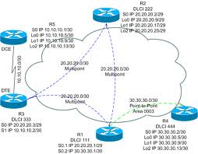
Packet Switching – Frame Relay
Frame Relay is based on using Virtual Circuits (VC);
A VC is a bidirectional virtual data circuit between two ports of any network, which works like a dedicated circuit;
There are two types of Virtual Tours:
Permanent Virtual Circuit (PVC);
Switched Virtual Circuit (SVC).

Slide 17
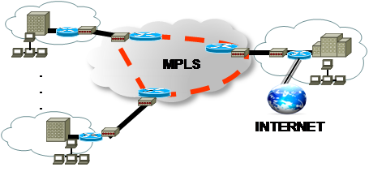
Packet Switching – MPLS
Multiprotocol Label Switching (MPLS) is a transport mechanism for data belonging to the family of packet switched networks.

Slide 18
Packet Switching – MPLS
Multiprotocol Label Switching (MPLS) is a mechanism in high-performance telecommunications networks which directs and carries data from one network node to the next with the help of labels. MPLS makes it easy to create "virtual links" between distant nodes. It can encapsulate packets of various network protocols.
highly scalable;
protocol agnostic;
data-carrying mechanism;
data packets are assigned labels.
MPLS operates at an OSI Model layer that is generally considered to lie between traditional definitions of Layer 2 (Data Link Layer) and Layer 3 (Network Layer), and thus is often referred to as a "Layer 2.5" protocol.

Slide 19
Summary
The circuit switching, which establishes a virtual connection between two nodes for their exclusive use during transmission (even when there is nothing to transmit). Packet switching is used to optimize the use of the bandwidth of the network, minimize latency (ie, the time that the packet takes to traverse the network) and increase robustness of communication.

Slide 20
Questions

