Slide 1
Data Communications and Networks
Chapter 5 – Network Services DNS, DHCP, FTP and SMTP
ICT-BVF8.1- Data Communications and Network Trainer: Dr. Abbes Sebihi

Slide 2
Agenda
Objective;
Pre-Assessment;
Network Services;
DNS;
DHCP;
FTP;
SMTP.
Summary
ICT-BVF8.1- Data Communications and Network Trainer: Dr. Abbes Sebihi

Slide 3
Objective
By the end of this lesson, the student will be able to understand how the main network protocols work: DNS, DHCP, FTP and SMTP.
ICT-BVF8.1- Data Communications and Network Trainer: Dr. Abbes Sebihi

Slide 4
Pre-assessment
What do you know about?
DNS (Domain Name System);
DHCP (Dynamic Host Configuration Protocol);
FTP (File Transfer Protocol);
SMTP (Simple Mail Transfer Protocol).
ICT-BVF8.1- Data Communications and Network Trainer: Dr. Abbes Sebihi

Slide 5
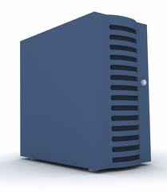
DNS (Domain Name System)
The DNS (Domain Name System) is a management system and distributed hierarchical name to operate under two definitions:
Review and update your database;
Resolving domain names into network addresses (IPs).
www.google.com
74.125.155.103
DNS Server
ICT-BVF8.1- Data Communications and Network Trainer: Dr. Abbes Sebihi

Slide 6
DNS (Domain Name System)
Due to the size of the Internet, store all the pairs field - a single IP address in DNS server would be impractical for reasons of scalability, including:
Availability: If the only DNS server fails, the service would become unavailable to the world;
Traffic volume: the server should handle the DNS requests from the entire planet;
Distance: most users would be far from the server, wherever it was installed and causing major delays to resolve DNS requests;
Maintaining the database: the database should store a huge amount of data and would have to be updated with a very high frequency, every time a domain was associated with an IP address.
ICT-BVF8.1- Data Communications and Network Trainer: Dr. Abbes Sebihi

Slide 7
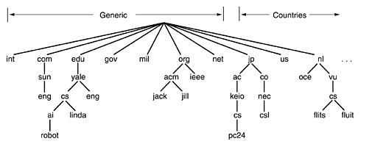
DNS (Domain Name System)
Because of those reasons, the DNS was designed in a hierarchical architecture to have multiple DNS servers around the world.
ICT-BVF8.1- Data Communications and Network Trainer: Dr. Abbes Sebihi

Slide 8
DNS (Domain Name System)
A DNS server consults three name servers to resolve the address www.google.com.The process entails:
A network host is configured with an initial cache (so called hints) of the known addresses of the root nameservers. Such a hint file is updated periodically by an administrator from a reliable source;
A query to one of the root servers to find the server authoritative (who is responsible for the domain name) for the top-level domain;
A query to the obtained forward server for the address of a DNS server authoritative for the second-level domain;
Repetition of the previous step to process each domain name label in sequence, until the final step which returns the IP address of the host sought.
www.google.com
74.125.155.103
DNS Server
ICT-BVF8.1- Data Communications and Network Trainer: Dr. Abbes Sebihi

Slide 9
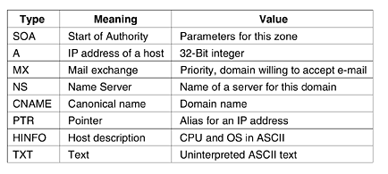
DNS (Domain Name System)
Resource Records
Every domain, whether it is a single host or a top-level domain, can have a set of resource records associated with it.
ICT-BVF8.1- Data Communications and Network Trainer: Dr. Abbes Sebihi

Slide 10
DHCP (Dynamic Host Configuration Protocol)
DHCP (Dynamic Host Configuration Protocol) is a service used to automate the configuration of the TCP/IP on the network devices (computers, printers, hubs, switches, or any device connected to network and is using the TCP/IP).
Without any DHCP implemented, the network administrator would have to configure, by hand, the TCP/IP properties on each network device;
By using DHCP, this task can be completely automated.
Benefits
Process automation when configuring TCP / IP devices in the network;
Ease of changing parameters such as Default Gateway, DNS Server and so on, all network devices via a simple change in the DHCP server;
Elimination of setup errors such as mistyping a subnet mask, or use the same IP on both devices, generating an IP conflict.
ICT-BVF8.1- Data Communications and Network Trainer: Dr. Abbes Sebihi

Slide 11
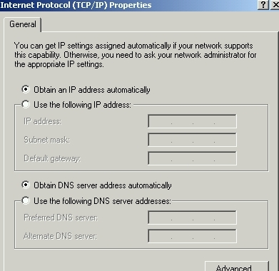
DHCP (Dynamic Host Configuration Protocol)
Using DHCP you can automatically configure:
IP address;
Subnet Mask
Default Gateway (Default Gateway);
IP address of one or more DNS servers;
IP address of one or more WINS servers;
DNS search suffixes.
ICT-BVF8.1- Data Communications and Network Trainer: Dr. Abbes Sebihi

Slide 12
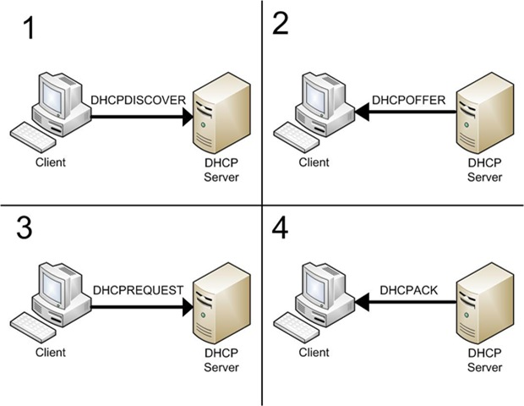
DHCP (Dynamic Host Configuration Protocol)
How does it work?
ICT-BVF8.1- Data Communications and Network Trainer: Dr. Abbes Sebihi

Slide 13
DHCP (Dynamic Host Configuration Protocol)
DHCP discovery
The client broadcasts messages on the physical subnet to discover available DHCP servers;
A DHCP client can also request its last-known IP address (in the example below, 192.168.1.100);
An authoritative server will deny the request, making the client ask for a new IP address immediately;
A non-authoritative server simply ignores the request, leading to an implementation-dependent timeout for the client to give up on the request and ask for a new IP address.
ICT-BVF8.1- Data Communications and Network Trainer: Dr. Abbes Sebihi

Slide 14
DHCP (Dynamic Host Configuration Protocol)
DHCP offer
When a DHCP server receives an IP lease request from a client, it reserves an IP address for the client and extends an IP lease offer by sending a DHCPOFFER message to the client;
The server determines the configuration based on the client's hardware address as specified in the CHADDR (Client Hardware Address) field. Here the server, 192.168.1.1, specifies the IP address in the YIADDR (Your IP Address) field.
ICT-BVF8.1- Data Communications and Network Trainer: Dr. Abbes Sebihi

Slide 15
DHCP (Dynamic Host Configuration Protocol)
DHCP request
A client can receive DHCP offers from multiple servers, but it will accept only one DHCP offer and broadcast a DHCP request message;
Based on the Transaction ID field in the request, servers are informed whose offer the client has accepted.
ICT-BVF8.1- Data Communications and Network Trainer: Dr. Abbes Sebihi

Slide 16
DHCP (Dynamic Host Configuration Protocol)
DHCP acknowledgement
When the DHCP server receives the DHCPREQUEST message from the client, the configuration process enters its final phase;
The acknowledgement phase involves sending a DHCPACK packet to the client;
At this point, the IP configuration process is completed.
DHCP releasing
The client sends a request to the DHCP server to release the DHCP information and the client deactivates its IP address.
ICT-BVF8.1- Data Communications and Network Trainer: Dr. Abbes Sebihi

Slide 17
FTP(File Transfer Protocol)
The transfer of data in computer networks usually involves file transfer and access to remote file systems
Very quick and versatile way to transfer files, one of the most used on the Internet.
ICT-BVF8.1- Data Communications and Network Trainer: Dr. Abbes Sebihi

Slide 18
FTP(File Transfer Protocol)
How does it work?
File transfer is between a computer called "client" (one who calls the connection for data transfer) and a server (the one that receives the transfer request). The user, through a specific software, you can select which files to send or receive from the server.
A client makes a TCP connection to the server's port 21;
This connection, called the control connection, remains open for the duration of the session, with a second connection, called the data connection, either opened by the server from its port 20 to a negotiated client port (active mode).
ICT-BVF8.1- Data Communications and Network Trainer: Dr. Abbes Sebihi

Slide 19
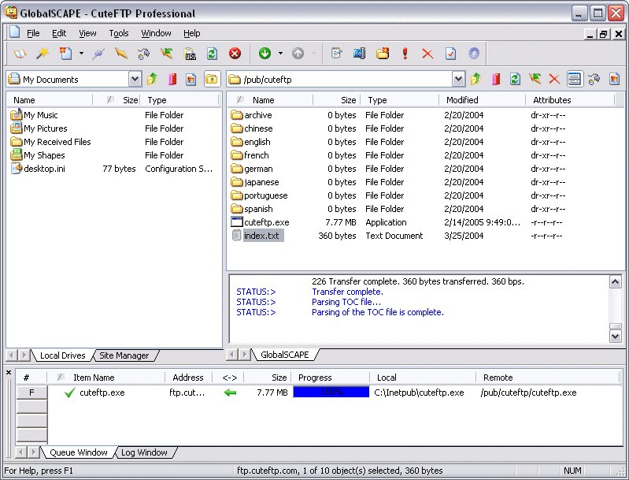
FTP(File Transfer Protocol)
FTP Clients
SmartFTP;
Cute FTP;
FTP via Web;
Filezilla;
FireFTP.
ICT-BVF8.1- Data Communications and Network Trainer: Dr. Abbes Sebihi

Slide 20
SMTP (Simple Mail Transfer Protocol)
SMTP is a relatively simple, based on plain text, where one or more recipients of a message are specified (and in most cases verified to exist) and then, the message transferred. It is quite easy to test an SMTP server using the telnet program.
This protocol runs over port 25 TCP. DNS resolution of an SMTP server for a given area is provided by the MX (Mail eXchange);
SMTP is a protocol for sending only, which means it does not allow a user to download messages from a server;
Within the Internet, e-mail is delivered by having the source machine establish a TCP connection to port 25 of the destination machine. Listening to this port is an e-mail daemon that speaks SMTP;
This daemon accepts incoming connections and copies messages from them into the appropriate mailboxes;
If a message cannot be delivered, an error report containing the first part of the undeliverable message is returned to the sender.
ICT-BVF8.1- Data Communications and Network Trainer: Dr. Abbes Sebihi

Slide 21
SMTP (Simple Mail Transfer Protocol)
How does it work?
Email is submitted by a mail client (MUA, mail user agent) to a mail server (MSA, mail submission agent) using SMTP on TCP port 25;
From there, the MSA delivers the mail to its mail transfer agent (MTA, mail transfer agent);
Local processing can be done either on a single machine, or split among various appliances;
The boundary MTA has to locate the target host. It uses the Domain name system (DNS) to look up the mail exchanger record (MX record) for the recipient's domain (the part of the address on the right of @);
The returned MX record contains the name of the target host;
The MTA next looks up the A record for that name in order to get the IP address and connect to such host as an SMTP client;
Once the MX target accepts the incoming message, it hands it to a mail delivery agent (MDA) for local mail delivery.
ICT-BVF8.1- Data Communications and Network Trainer: Dr. Abbes Sebihi

Slide 22
SMTP (Simple Mail Transfer Protocol)
How does it work?
ICT-BVF8.1- Data Communications and Network Trainer: Dr. Abbes Sebihi

Slide 23
Summary
We have presented 4 of the most important network protocols.
Without the DNS, the Internet does not work properly. The Internet has dependency on the DNS systems.
The DHCP is essential to manage a network. It’s almost impossible to manage a large network without DHCP in place to assign IP addresses and configure the network.
The FTP protocol is very important when you are trying to transfer files to other computer or network. A simple way and very user friendly to exchange files.
The STMP protocol is essential to mail exchange. Without it, it’s not possible to send email to companies, friends etc.
ICT-BVF8.1- Data Communications and Network Trainer: Dr. Abbes Sebihi

Slide 24
Questions

