Slide 1
Data Communications and Networks
Chapter 6 – IP, UDP and TCP
ICT-BVF8.1- Data Communications and Network Trainer: Dr. Abbes Sebihi

Slide 2
Agenda
IP (Internet Protocol);
TCP (Transmission Control Protocol);
UDP (User Datagram Protocol);
Summary
ICT-BVF8.1- Data Communications and Network Trainer: Dr. Abbes Sebihi

Slide 3
Objective
By the end of this lesson, the student will be able to understand how IP, TCP and UDP work.
ICT-BVF8.1- Data Communications and Network Trainer: Dr. Abbes Sebihi

Slide 4
Pre-assessment
What do you know about?
IP;
TCP;
UDP.
ICT-BVF8.1- Data Communications and Network Trainer: Dr. Abbes Sebihi

Slide 5
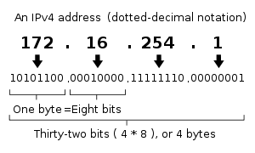
IP (Internet Protocol)
The IP (Internet Protocol), generically, is an address that indicates the location of a particular piece of equipment (usually computers) in a private or public network.
The IP address, version 4 (IPv4), is a 32-bit number written as four octets represented in decimal format:
The first part of the address identifies a specific network in the inter-network;
The second part identifies a host within that network.
ICT-BVF8.1- Data Communications and Network Trainer: Dr. Abbes Sebihi

Slide 6
IP (Internet Protocol)
IP Addressing and Routing
Most complex aspects of IP are IP addressing and routing. Addressing refers to how end hosts become assigned IP addresses and how subnetworks of IP host addresses are divided and grouped together.
Class | IP Address Range | Number of Network Address
A | 1.0.0.0 to 127.0.0.0 | 16 777 216
B | 128.0.0.0 to 191.255.255.255 | 65 536
C | 192.0.0.0 to 223.255.255.255 | 256
D | 224.0.0.0 to 239.255.255.255 | Multicast
E | 240.0.0.0 to 247.255.255.254 | Future Use
IP Address Range
ICT-BVF8.1- Data Communications and Network Trainer: Dr. Abbes Sebihi

Slide 7
IP (Internet Protocol)
Reliability
The design principles of the Internet protocol assume that the network infrastructure is inherently unreliable;
For the benefit of reducing network complexity, the intelligence in the network is purposely mostly located in the end nodes of each data transmission;
Routers in the transmission path simply forward packets to the next known local gateway matching the routing prefix for the destination address;
The Internet Protocol only provides best effort delivery and its service can also be characterized as unreliable;
In network architectural language it is a connection-less protocol;
The lack of reliability allows any of the following fault events to occur:
data corruption
lost data packets
duplicate arrival
ICT-BVF8.1- Data Communications and Network Trainer: Dr. Abbes Sebihi

Slide 8
UDP (User Datagram Protocol)
The Internet protocol suite supports a connectionless transport protocol;
UDP provides a way for applications to send encapsulated IP datagrams;
Send them without having to establish a connection;
UDP transmits segments consisting of an 8-byte header followed by the payload
Features
Connection-less, no error control, no flow control.
UDP header carries information on Source Port, Destination Port, and others.
Sends data directly without establishing connection.
ICT-BVF8.1- Data Communications and Network Trainer: Dr. Abbes Sebihi

Slide 9
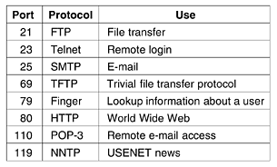
TCP (Transmission Control Protocol)
UDP is a simple protocol and it has some niche uses, such as client-server interactions and multimedia, but for most Internet applications, reliable, sequenced delivery is needed.
TCP (Transmission Control Protocol) was specifically designed to provide a reliable end-to-end byte stream over an unreliable internetwork:
TCP service is obtained by both the sender and receiver creating end points, called sockets;
Each socket has a socket number (address) consisting of the IP address of the host and a 16-bit number local to that host, called a port.
Port numbers below 1024 are called well-known ports and are reserved for standard services.
ICT-BVF8.1- Data Communications and Network Trainer: Dr. Abbes Sebihi

Slide 10
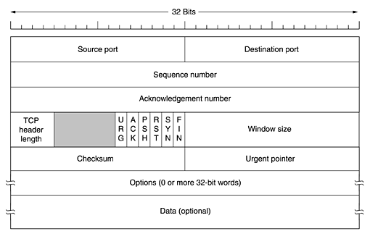
TCP (Transmission Control Protocol)
The TCP Segment Header
Every segment begins with a fixed-format, 20-byte header. The fixed header may be followed by header options. After the options, if any, up to 65,535 - 20 - 20 = 65,495 data bytes may follow, where the first 20 refer to the IP header and the second to the TCP header.
ICT-BVF8.1- Data Communications and Network Trainer: Dr. Abbes Sebihi

Slide 11
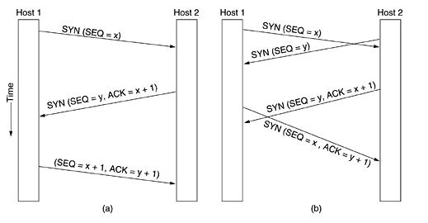
TCP (Transmission Control Protocol)
TCP Connection Establishment
Connections are established in TCP by means of the three-way handshake. To establish a connection, one side, say, the server, passively waits for an incoming connection by executing the LISTEN and ACCEPT primitives, either specifying a specific source or nobody in particular.
ICT-BVF8.1- Data Communications and Network Trainer: Dr. Abbes Sebihi

Slide 12
TCP (Transmission Control Protocol)
TCP Connection Establishment
The other side, say, the client, executes a CONNECT primitive, specifying the IP address and port to which it wants to connect, the maximum TCP segment size it is willing to accept, and optionally some user data (e.g., a password). The CONNECT primitive sends a TCP segment with the SYN bit on and ACK bit off and waits for a response.
ICT-BVF8.1- Data Communications and Network Trainer: Dr. Abbes Sebihi

Slide 13
TCP (Transmission Control Protocol)
TCP Connection Establishment
When this segment arrives at the destination, the TCP entity their checks to see if there is a process that has done a LISTEN on the port given in the Destination port field. If not, it sends a reply with the RST bit on to reject the connection.
ICT-BVF8.1- Data Communications and Network Trainer: Dr. Abbes Sebihi

Slide 14
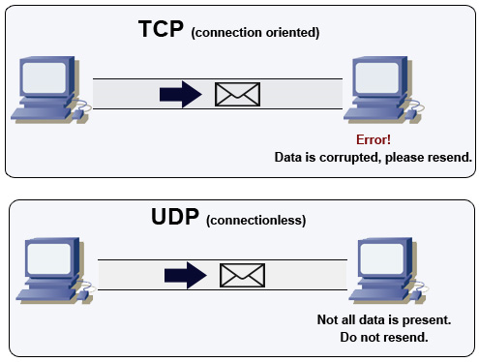
TCP (Transmission Control Protocol)
Features
Connection-based, with error control and flow control
TCP header carries information on Source Port, Destination Port, Sequence Number, Acknowledge Number, Control Flags, Window, and others.
Sequence Number and Acknowledge Number are for error control and dealing with out-of-order packages, Window is for flow control, and Control Flags are for connection control;
Establish connection before sending / receiving data
ICT-BVF8.1- Data Communications and Network Trainer: Dr. Abbes Sebihi

Slide 15
TCP (Transmission Control Protocol)
TCP Congestion Control
TCP limits the amount of data it sends in order to avoid causing congestion on the network;
TCP’s “congestion window” specifies the amount of data in flight at any point in time;
For each segment acknowledged by the receiver, the sender can transmit one new segment.
ICT-BVF8.1- Data Communications and Network Trainer: Dr. Abbes Sebihi

Slide 16
Summary
TCP/IP is the most important suite for the Internet. On this class we were able to present the best features of IP, TCP and UDP. They are all important to transmit date over the network.
IP is responsible to address the packet and find a path to send it, but the transport will be made by the transmission protocols TCP and UDP.
Even with some limitation, UDP is used to care on date faster that does need connection or congestion control.

Slide 17
Questions
ICT-BVF8.1- Data Communications and Network Trainer: Dr. Abbes Sebihi

