Slide 1
Data Communications and Networks
Chapter 9 – Distributed Systems
ICT-BVF8.1- Data Communications and Network Trainer: Dr. Abbes Sebihi

Slide 2
Agenda
Objective;
What is distributed systems?
Architecture;
Client-Server;
3-Tier Architecture;
Clusters;
Summary;
ICT-BVF8.1- Data Communications and Network Trainer: Dr. Abbes Sebihi

Slide 3
Objective
By the end of this lesson, the student will understand how the IP addresses work and how to calculate a subnet address.
ICT-BVF8.1- Data Communications and Network Trainer: Dr. Abbes Sebihi

Slide 4
Pre-assessment
What do you know about?
Distributed Systems;
Client-Server Architecture;
Peer-to-Peer.
ICT-BVF8.1- Data Communications and Network Trainer: Dr. Abbes Sebihi

Slide 5
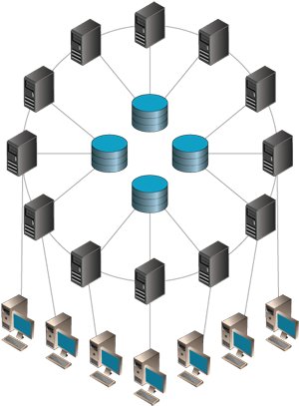
Distributed Systems
A collection of autonomous computers linked via a computer network and equipped with software that allows sharing of system resources: hardware, software and data.
The distributed computing is to add the computational power of multiple computers interconnected by a computer network;
More than one processor working together on the same computer, to process a given task collaboratively in a coherent and transparent;
If only one single centralized computer was performing a task;
The union of these different computers with the goal of sharing the execution of tasks is known as a distributed system.
ICT-BVF8.1- Data Communications and Network Trainer: Dr. Abbes Sebihi

Slide 6
Architecture
Client–server: Smart client code contacts the server for data then formats and displays it to the user. Input at the client is committed back to the server when it represents a permanent change;
3-tier architecture: Three tier systems move the client intelligence to a middle tier so that stateless clients can be used. This simplifies application deployment. Most web applications are 3-Tier;
Clustered: refers typically to a cluster of machines that closely work together, running a shared process in parallel. The task is subdivided in parts that are made individually by each one and then put back together to make the final result;
Peer-to-peer (P2P): an architecture where there is no special machine or machines that provide a service or manage the network resources. Instead all responsibilities are uniformly divided among all machines, known as peers. Peers can serve both as clients and servers.
ICT-BVF8.1- Data Communications and Network Trainer: Dr. Abbes Sebihi

Slide 7
Client-Server
Client/Server is a computer model that separates client and server and usually connected via a computer network;
Each instance of a client can send data requests to one of the servers online and expect a response;
Servers can accept these requests, process them and return the result to the client;
Often clients and servers communicate through a computer network with separate hardware, but the client and server can reside on the same system (standalone environment).
ICT-BVF8.1- Data Communications and Network Trainer: Dr. Abbes Sebihi

Slide 8
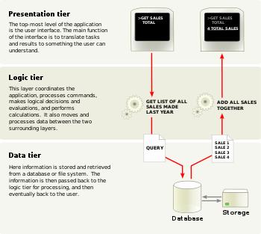
3-Tier Architecture
Three-tier model, derived from template 'n' layers, receive this designation when a client-server system is developed by removing the layer of business from the client side.
Presentation tier (layer)
This is the topmost level of the application.
Application tier
The logic tier is pulled out from the presentation tier and, as its own layer, it controls an application’s functionality by performing detailed processing
Data tier
This tier consists of database servers.
ICT-BVF8.1- Data Communications and Network Trainer: Dr. Abbes Sebihi

Slide 9
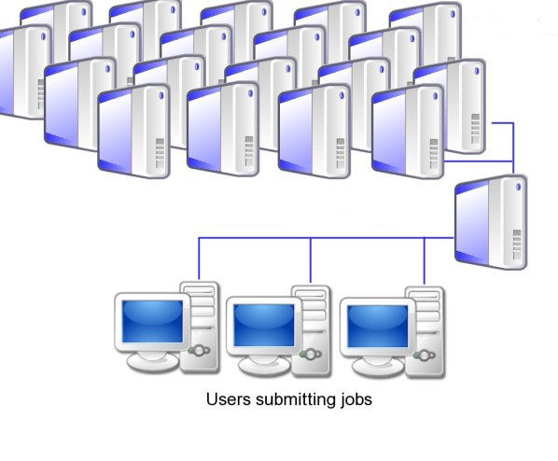
Clusters
A computer cluster is a group of linked computers, working together closely thus in many respects forming a single computer.
High-availability (HA) clusters
Load Balancing
Computer Clusters
ICT-BVF8.1- Data Communications and Network Trainer: Dr. Abbes Sebihi

Slide 10
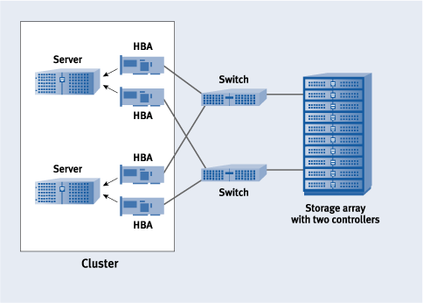
High Availability (HA)
They are implemented primarily for the purpose of improving the availability of services that the cluster provides.
They operate by having redundant nodes, which are then used to provide service when system components fail;
The most common size for an HA cluster is two nodes, which is the minimum requirement to provide redundancy
ICT-BVF8.1- Data Communications and Network Trainer: Dr. Abbes Sebihi

Slide 11
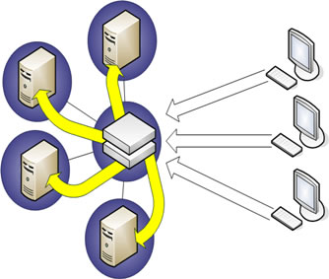
Load Balancing
Load-balancing is when multiple computers are linked together to share computational workload or function as a single virtual computer.
Logically, from the user side, they are multiple machines, but function as a single virtual machine;
Requests initiated from the user are managed by, and distributed among, all the standalone computers to form a cluster;
This results in balanced computational work among different machines, improving the performance of the cluster systems.
ICT-BVF8.1- Data Communications and Network Trainer: Dr. Abbes Sebihi

Slide 12
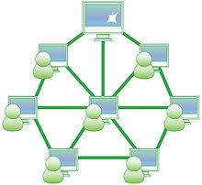
Peer-to-Peer
It is an architecture of distributed systems characterized by the decentralization of the network, where each node performs both functions of server and client.
One of the goals of peer-to-peer is to allow sharing of data and resources on a large scale by eliminating any requirement for servers that are managed separately and its associated infrastructure;
Peer-to-peer networks are designed to support distributed applications;
Systems using the computational resources available on personal computers and workstations in increasing numbers.
ICT-BVF8.1- Data Communications and Network Trainer: Dr. Abbes Sebihi

Slide 13
Summary
Distributed systems are networked computers operating with same processors. No matter what you do, the basic idea of distributed systems is to share the process work with other.
In this class, we saw many ways of using distributed systems on the network 3-tier, peer-to-peer and clusters.
ICT-BVF8.1- Data Communications and Network Trainer: Dr. Abbes Sebihi

Slide 14
Questions

